Slide 1
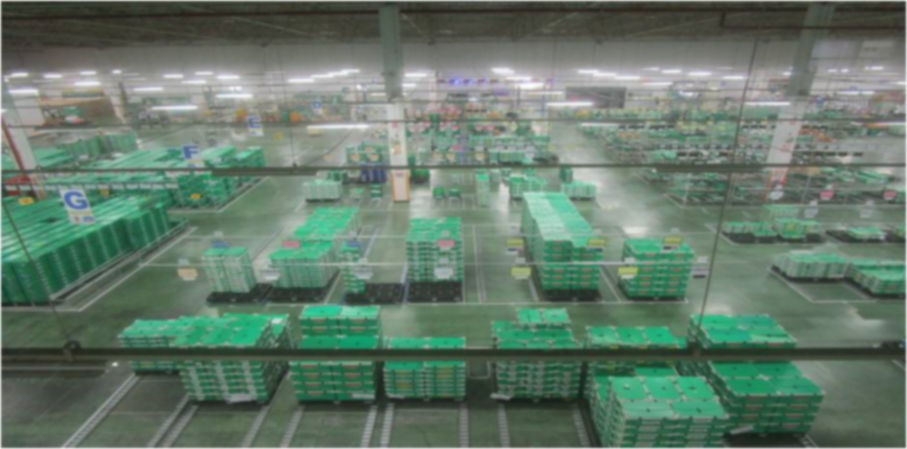
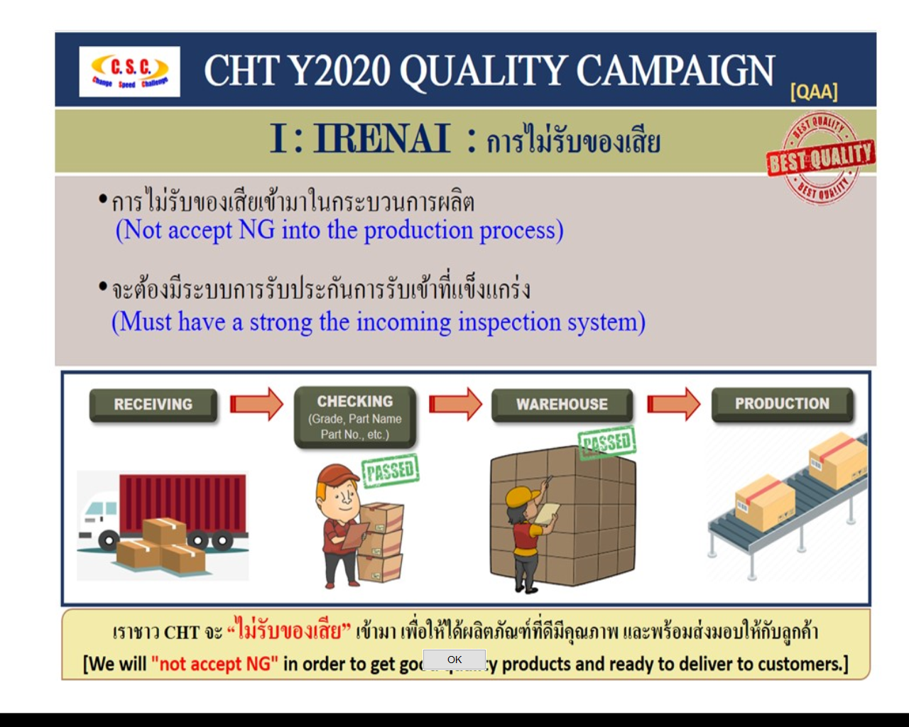

LCA
Rec.
Store
IM
HOME
About us 
ISO Document 
Activity 
IT Project 
Inventory control
- Daily stock
- Report
Select Color :
Store control
- Layout
- Report
Admin & Defect control
D
omestic
- ECN
B
- MT
utsuryu
C
- EOL
ontrol
- Report
Milk run
- Supplier milkrun
- Report
Package
- Stock control
- Report

